Slide 1










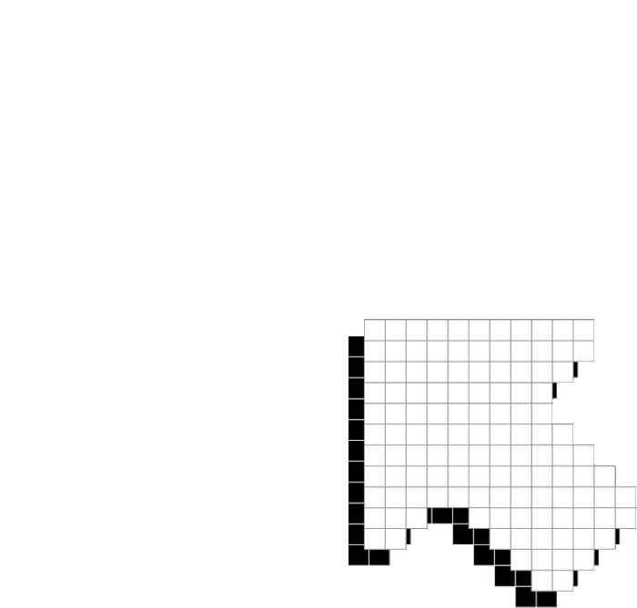




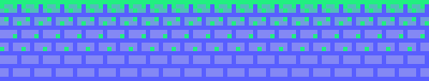
PLAYER 1
HIGHSCORE 2500
PLAYER 2
RAMPAGE
SPRINT 2
AARON beasley, tameka ferguson, shikha sawant, andrea florence

Slide 2









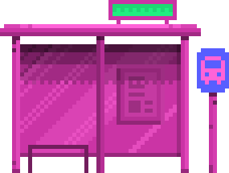


01
07
12
OVERVIEW & GOALS
UPDATED TECHINCAL REQUIREMENTS
AGENDA
FUNCTIONAL
NON-FUNCTIONAL
BEHAVIOR UML DIAGRAMS
STRUCTURAL UML DIAGRAMS
SYSTEM BOUNDARIES
PHYSICAL
LOGICAL
GANTT CHART
RISK ANALYSIS
ORGANIZATIONAL APPROACH

Slide 3

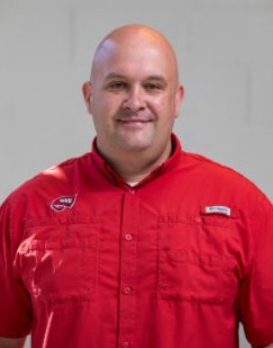
01
07
12
PROJECT OVERVIEW AND GOALS
The goal of this project is to recreate one level of the game, Rampage, as close to the original as possible.
the project provides users with a game that challenges hand-eye coordination. Players must be able to think and move quickly to avoid being shot by soldiers as they destroy structures, while keeping their health up.
Audience: Dr. Galloway

Slide 4
01
07
12
FUNCTIONAL REQUIREMENTS
MANDATORY
PLAYER CONTROLS
MOVING? JUMPING? CLIMBINB?
ACCESSING A MENU
INUJRY
NON- MANDATORY
HOW MUCH CAN THE HEALTH LOWER WITH EACH HIT?
INUJRY
PLAYER ACCOUNTS
PROGRAMMING INFLICTIONS
HOW WILL THE PLAYERS’ DATA BE SAVED? LOGGING IN?
VISUALS
AESTHETICS
MULTIPLE ACCOUNTS?
ENVIRONMENT
NPCS/VEHICLES
ENVIRONMENT SIZE
DYING FROM PLAYER
BUILDING SIZE
INFLICTING DAMAGE
MOVEMENTS
WHAT MOVES/DOESN’T MOVE
BUILDINGS
GRAPHICS
TAKE DAMAGE
COLOR SCHEME
HOLD NPCS
Notes:
critically think and ask certain questions
controls will be mainly the keyboard/no touchpad
WITHIN SCOPE/ NOT IN SCOPE

Slide 5
01
07
12
NON-FUNCTIONAL REQUIREMENTS
NON- MANDATORY
RESPONSE TIME
THEIR MOVEMENT AND DESIGN
LOADING TIME
MANDATORY
COMPATIBILITY AND ACCESSIBILITY
IMPLEMENTATION
USING UNITY
CPU/MEMORY USAGE
WINDOWS SOFTWARE
NETWORK PERFORMANCE
SECURITY
ASSUMING THIS GAME WOULD BE ACCESSED ONLINE
ENSURE PLAYER CANNOT CHEAT
METRICS
STORAGE
HARDWARE METRICS TBD
PROGRESS STORAGE
USER INTERFACE
CHANCES OF LAGGING?
BUTTONS WILL BE THE MAIN CONTROLS
BUGS
DEBUGGING

Slide 6








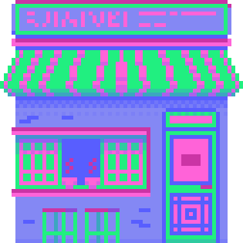





BEHAVIORAL UML DIAGRAMS

Slide 7
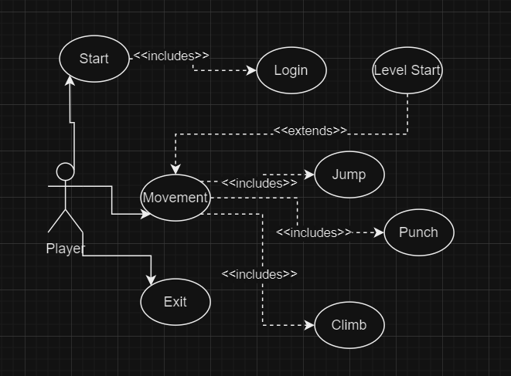
USE CASE DIAGRAM AND SCENARIOS

Slide 8
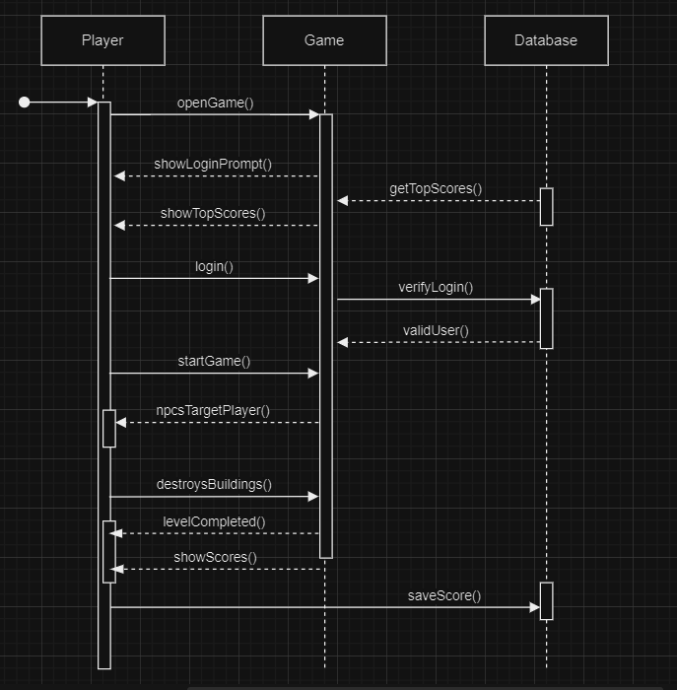
SEQUENCE DIAGRAM

Slide 9
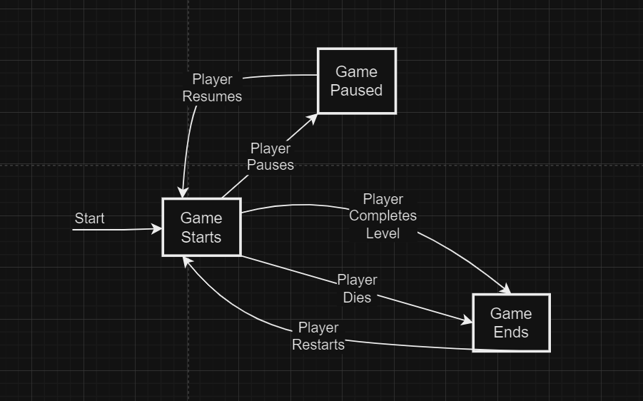
STATE DIAGRAM

Slide 10
STRUCTURAL UML DIAGRAMS

Slide 11
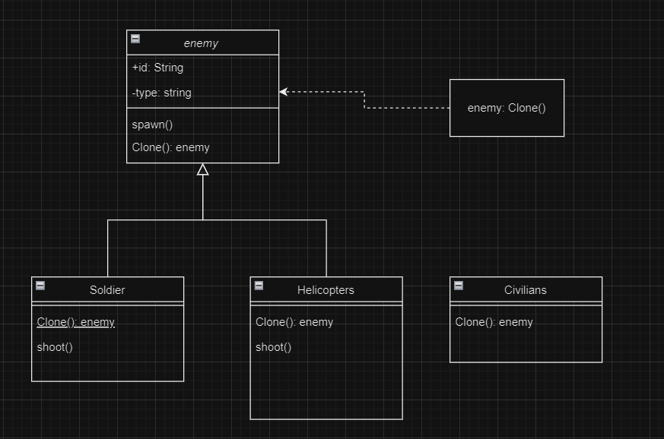
PROTOTYPE DESIGN PATTERN CLASS DIAGRAM

Slide 12
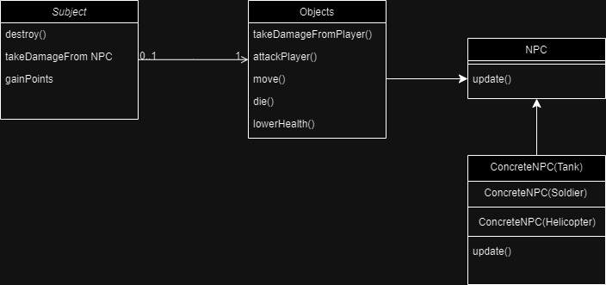
OBSERVER DESIGN PATTERN CLASS DIAGRAM

Slide 13
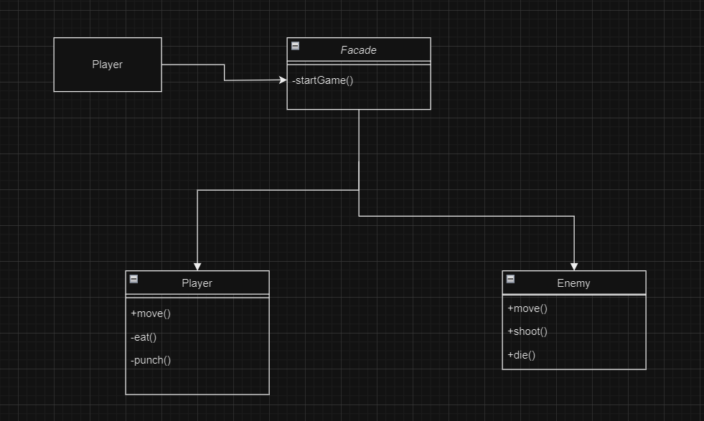
FAÇADE DESIGN PATTERN CLASS DIAGRAM

Slide 14
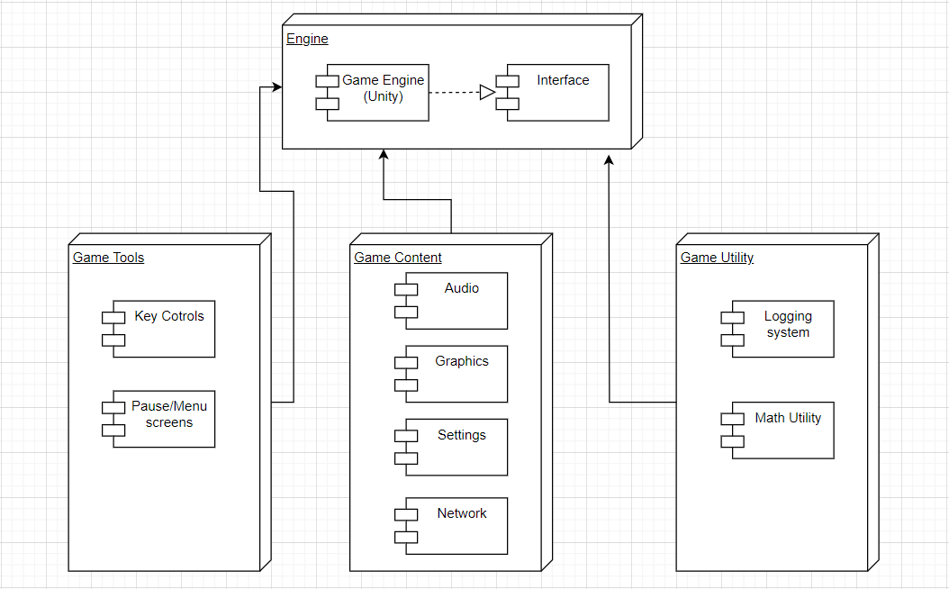
COMPONENT DIAGRAM

Slide 15
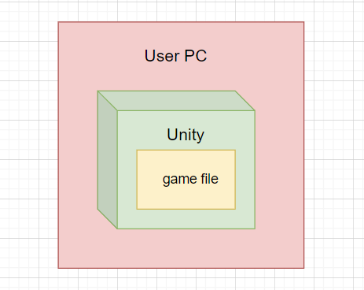
DEPLOYMENT DIAGRAM

Slide 16


01
07
12
Deployment Environment
User PC
PHYSICAL SYSTEM BOUNDARY
Network/Communication
Latency optimization
Secutity
Authentication and authorization
Scalability
No Scalibility for this project.

Slide 17

DEVELOPER REQUIREMENTS
MINIMUM REQUIREMENTS | WINDOWS DETAILS
OS VERSION | Windows 7 and newer, 64-bit versions only.
CPU | X64 architecture with SSE2 instruction set support
GRAPHICS API | DX10, DX11, and DX12-capable GPUs
ADDITIONAL REQUIREMENTS | Hardware vendor officially supported drivers
Notes:
we all have windows

Slide 18
PLAYER REQUIREMENTS
OPERATING SYSTEM | ANDROID | IOS
OS VERSION | 4.4 (API 19)+ | 11+
CPU | ARMv7 with Neon Support (32-bit) or ARM64 | A7 SoC+
GRAPHICS API | OpenGL ES 2.0+, OpenGL ES 3.0+, Vulkan | Metal
Free Disk space | 80GB of free disk space | 80GB of free disk space
Notes:
any modern device should be able to access this game

Slide 19
01
07
12
LOGICAL SYSTEM BOUNDARY
Game elements
Monster, buildings, npc
Game logic
rules, mechanisms, algorithms
level design/terrain
street, background, structure
state entities
positions and health scores

Slide 20
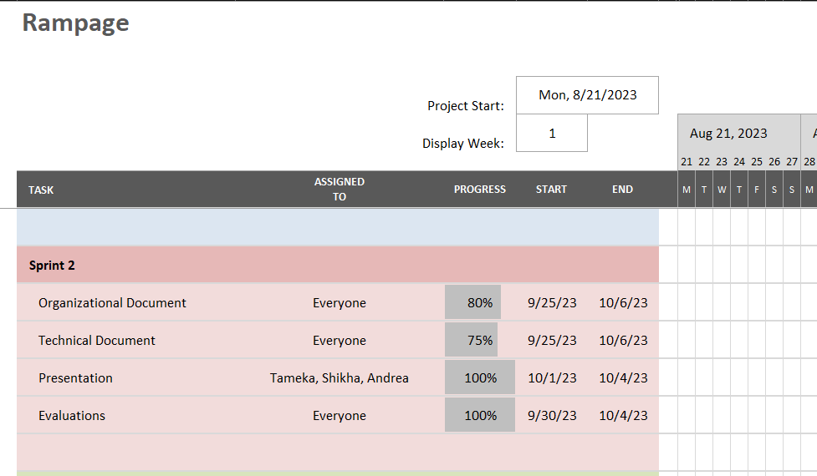
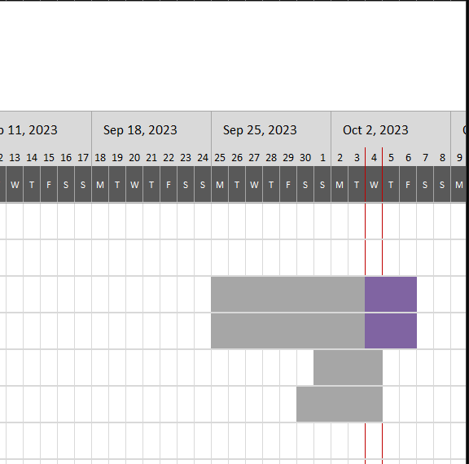
GANTT CHART

Slide 21
RISK
ANALYSIS

Slide 22
IDENTIFICATION AND PLANNING
Our planned course of action falls through
project share does not work
there is a possibility that our plan outlined in our documentation does not work, wee need to change things, or we might even realize we set something up wrong. be prepared to swerve.
Sharing the method via a drive has a lot of potential problems (files do not upload, cannot work at same time, etc.) Sharing via github also has potential bugs. Be prepared to send code to one computer to compile if need be.
code doesn’t mesh
Hold extra/emergency team meetings to re-evaluate the code as a whole, locate issues, and fix them as a team.
evaluate risks at
least once per week.

Slide 23
01
07
12
ORGANIZATIONAL
APPROACH
In class, 30 mins each wed. before client meetings.
Discord server communication.
HOW? WHEN? WHERE?
project manager - Andrea Florence

Slide 24

THANK YOU!
HOPE YOU ENJOYED!!!

